Slide 1
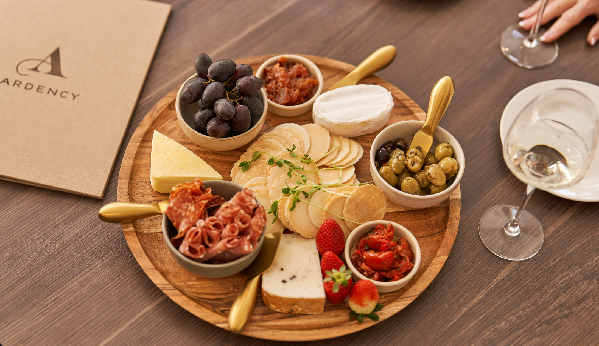




FOOD AND
BEVERAGE MENU

Slide 2


WINE
SPARKLING
Tempus Two Blanc de Blancs 200ml,
South Australia
$9.00 btl
WHITE
Black Pearl Chardonnay,
South Australia
$8.00 gls / $27.00 btl
Shell Bay Sauvignon Blanc,
Australia
$8.00 gls / $28.00 btl
Pinot Grigio,
South Australia
$9.00 gls / $29.00 btl
RED
Grigori Vintners Shiraz,
South Australia
Kings Roar Cabernet Sauvignon,
Australia
ROSE
Antares Rosé,
Chile
$8.00 gls / $28.00 btl
$9.00 gls / $29.00 btl
$9.00 gls / $29.00 btl

Slide 3

BEER
LOCAL BEER
Hahn (Light)
Great Northern (Mid Strength)
Young Henrys Ginger Beer
$7.50
$8.00
$9.50
INTERNATIONAL BEER
Peroni
$8.50

Slide 4
NON - ALCHOLIC
SOFT DRINK
Coke, Diet Coke, Coke Zero
Sprite, Solo
Ginger Beer
Pink Lemonade
Sparkling, Tonic, Soda Water
Lemon Lime & Bitters
MILKSHAKES
Chocolate, Strawberry, Carmel or Vanilla
$3.50
$3.50
$4.50
$3.50
$3.50
$4.50
Iced Coffee
Iced Chocolate
$6.00
$6.30
$6.00

Slide 5

COFFEE & TEA
SOFT DRINK
Espresso
Macchiato
Piccolo
Long Black
$3.50
$3.50
$3.50
$3.50 sml / $4.00 lg
Flat White
Cappuccino
Latte
$4.30 sml / $4.80 lg
$4.30 sml / $4.80 lg
$4.30 sml / $4.80 lg
Hot Chocolate
Mocha
Chai Latte
$4.30 sml / $4.80 lg
$4.30 sml / $4.80 lg
$4.30 sml / $4.80 lg
English Breakfast
Earl Grey
Green Tea
Peppermint Tea
Chamomile Tea
T2 Specialty Loose Leaf Tea
$4.00
$4.00
$4.50
$4.50
$4.50
$4.50
Extras
Decaf
Extra Shot
Soy Milk
$0.80
$0.80
$0.50

Slide 6
Starters
Chef’s Homemade Soup (gf) sml - $7.50 / lg - $10.00
Vegetarian Cannelloni w/ spinach, sundried tomato, ricotta in tomato herb sauce $17.00
Chicken Crepe w/ asparagus,, sundried tomato & baby spinach glazed w/ parmesan cheese $18.00
Soft Shell Fish Taco w/ lettuce, slaw, tomato salsa & lemon herb mayo $18.00
Asian Style Tempura Prawns w/ noodle salad & sweet chilli Hoisin dipping sauce $19.00
Mains
Steak Sandwich w/ Chips $22.00
lettuce, tomato & beetroot w/ cheese & BBQ sauce
Chicken Breast Caprese $30.00
filled w/ roasted capsicum, baby spinach, pepperoni & cream cheese on a garlic cream sauce
(gf/df on request) w/ chips & salad or potatoes & vegetables
Slow Braised Lamb Shank $31.00
w/ creamy mash potatoes & steamed vegetables
Panko Crumbed Salmon Croquettes $31.00
served on a warm roast vegetable salad w/ dill & lime mayo (gf)
Pork Medallions $34.00
Pan fried w/ mango sweet chili cream topped w/ prawns (gf) w/ chips & salad or potatoes & vegetables
Veal Aroona $34.00
lightly crumbed served w/ lemon caper herb sauce (gf/df on request)
w/ chips & salad or potatoes & vegetables
Beef Eye Fillet $42.00
beef eye fillet on a potato rosti topped w/ asparagus & bearnaise sauce (gf/df on request)
w/ salad or vegetables
Roast of the Day sml - $21.00 / lg - $25.00
w/ roast potatoes, steamed vegetables & pan juices (gf/df)
Fresh Fish of the Day sml - $24.00 / lg - $30.00
w/ chips & salad or potatoes & vegetables (gf/df on request)
Sides $6.00 each
Vegetables – roasted or steamed
Garden Salad or Coleslaw Bowl of Chips
Sweet Potato Chips
Desserts $10.00 each
Sticky Date Pudding w/ butter scotch & ice cream (gf)
Tia Maria Chocolate Mousse (gf)
Baked Cheesecake w/ fruit coulis & ice cream

